Slide 1
Assignment #1 Project #Employee management
Group Members:
AHMAD QUTAB
Adnan Mujahid
Ali Haider
Munaqib liaqat
Ameer Ali

Slide 2
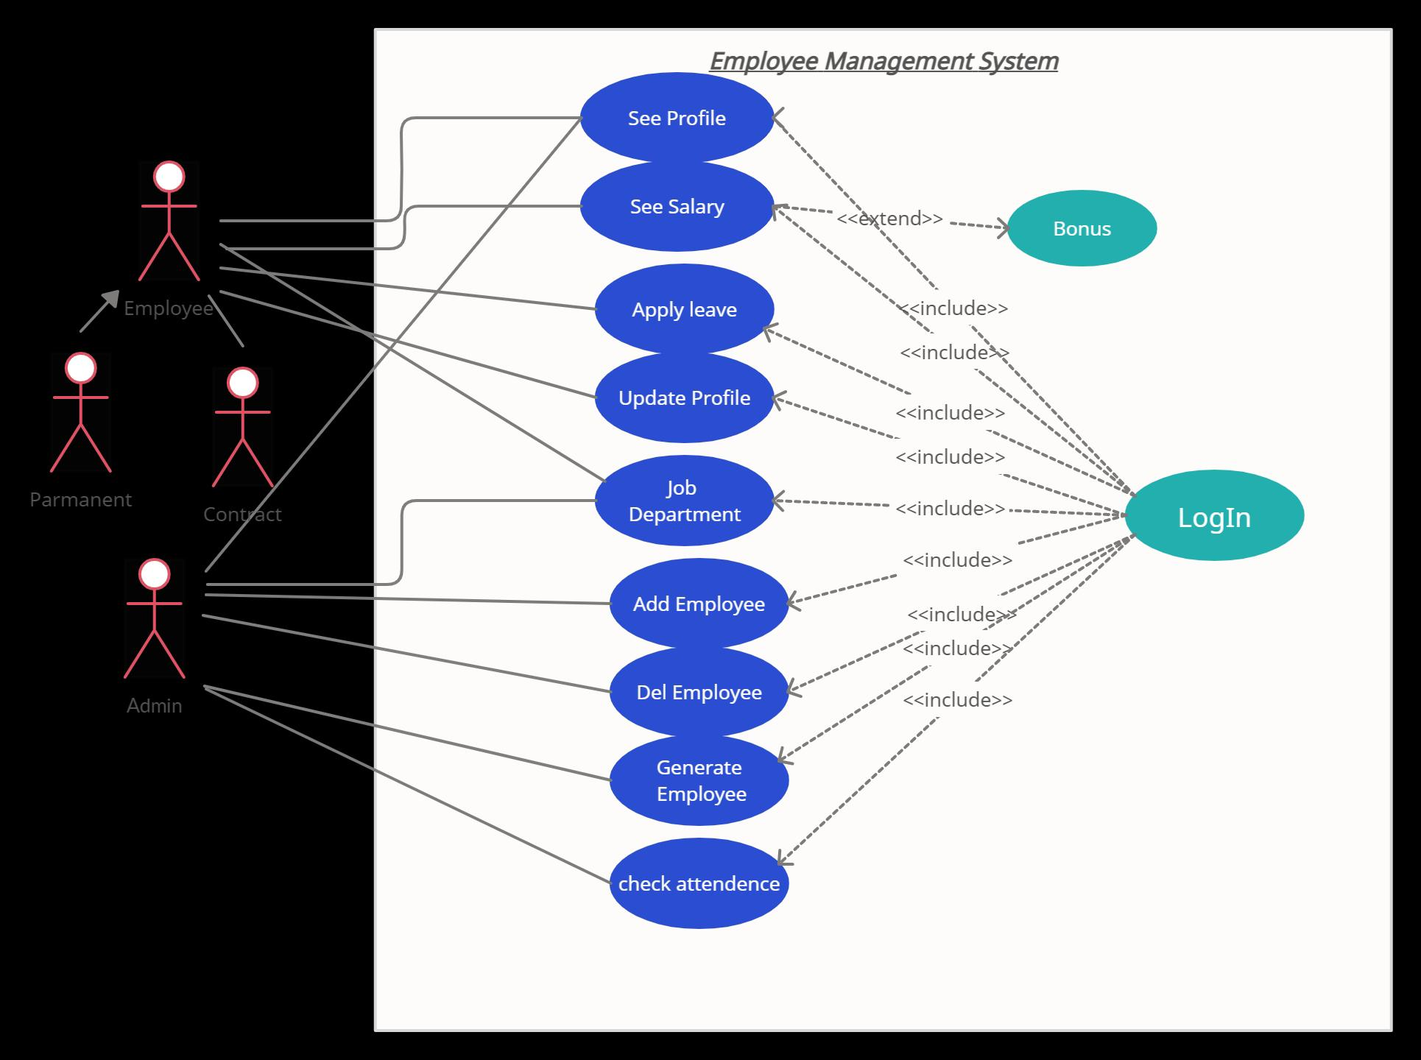

Slide 3
